Slide 1
FRONTLINE

Slide 2
Absence Management

Slide 3
Login Devices
Web Based System – Clocking in from a school computer. Kronos clocks in buildings will be replaced by laptops.
Frontline Mobile App – Allow you to clock in from your phone or tablet. Can only be done from with the district Wi-Fi.

Slide 4

Access – Frontline Login Web Based
app.frontlineeducation.com
Login information is employee created and used for both Absence Management and Time & Attendance.

Slide 5
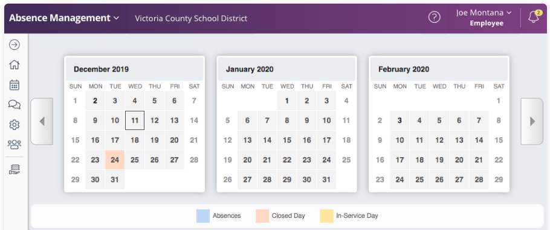
Absence Management Home Page
Calendar shows any dates an employee current has off, a district closed day or and in-service day.

Slide 6
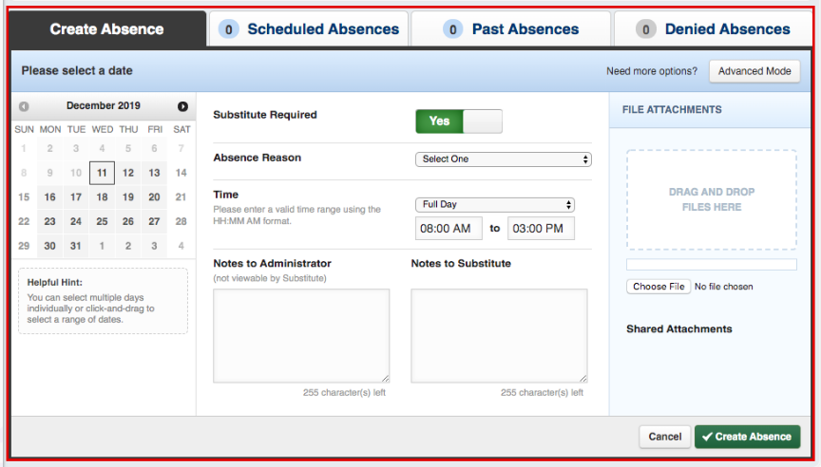
Absence Management Home Page
Detail box is where an employee will enter the absence information.
For Transportation, you will want to click on Advanced Mode.

Slide 7
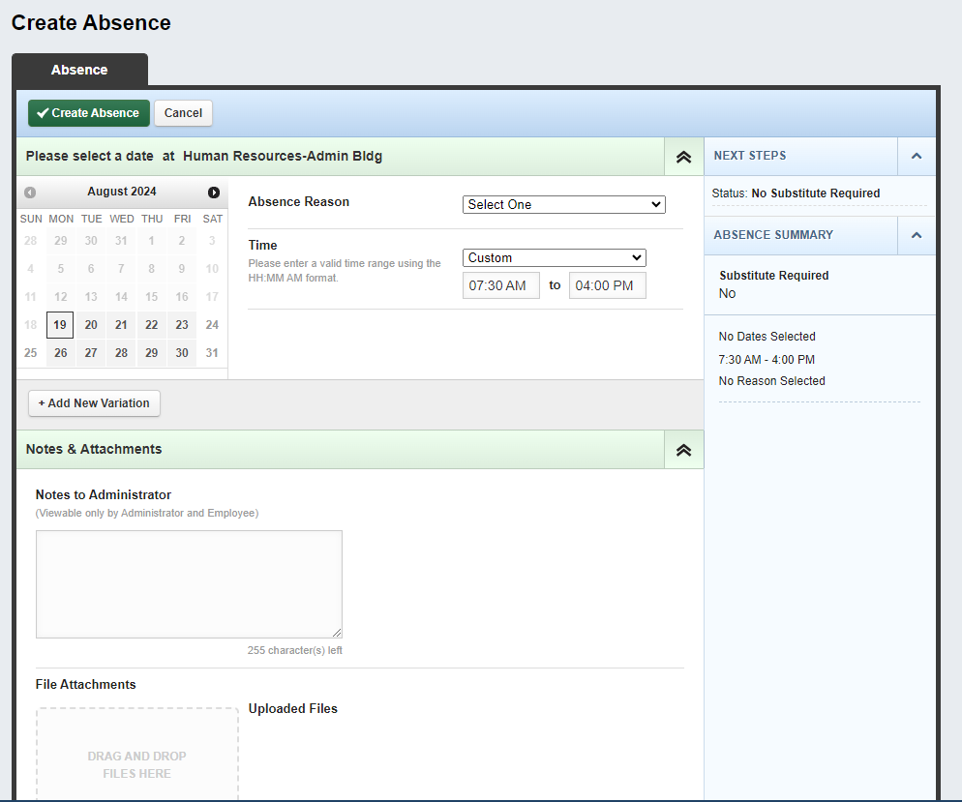
Creating an Absence
Select a date(s)
Click Add Variation
Reasons are a default. Select the reason for the absence.
Custom Absence Only

Slide 8
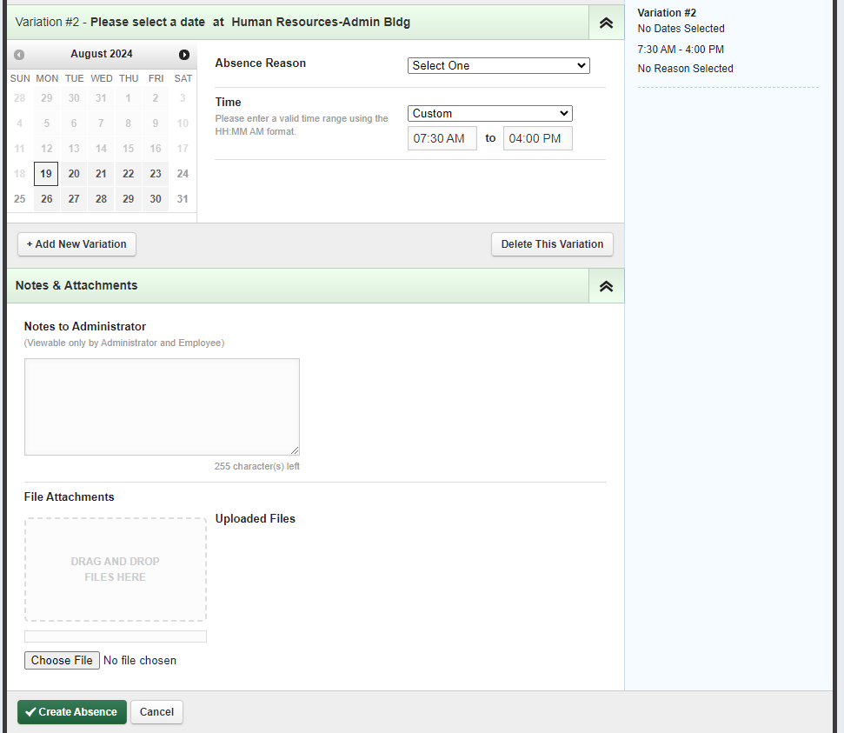
Creating an Absence- New Variation
Select a date(s)
Reasons are a default. Select the reason for the absence.
Custom Absence Only
Click Create Absence

Slide 9
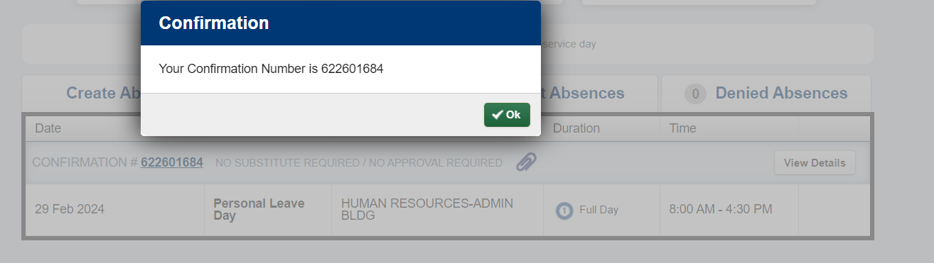
Creating an Absence
A confirmation number is provided once absence is created.
Click ok

Slide 10
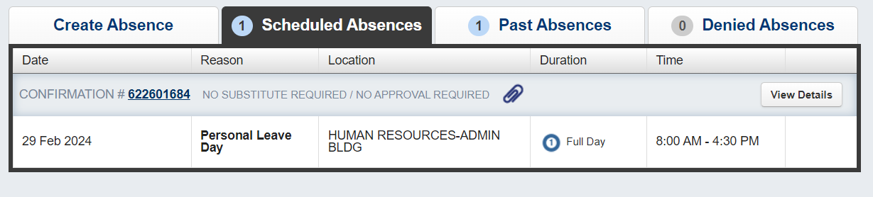
Scheduled Absences

Slide 11
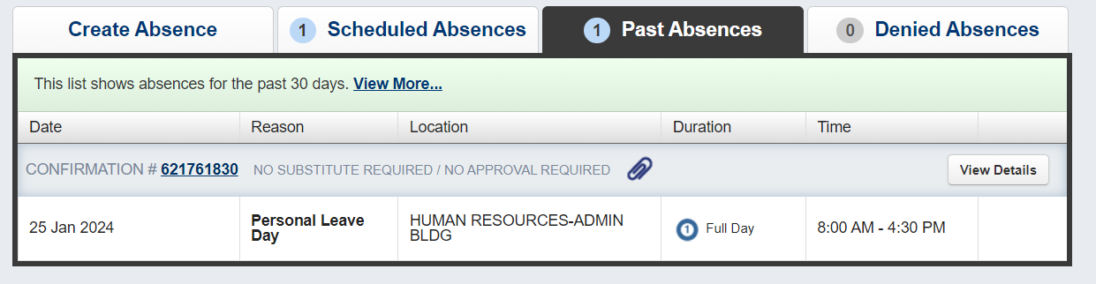
Past Absences

Slide 12
App Requirements
Employee phone must be connected to the district Wi-Fi
When the app first loads, you will be asked to allow the app to use your location. You must allow the app to use your location in order to punch in.

Slide 13
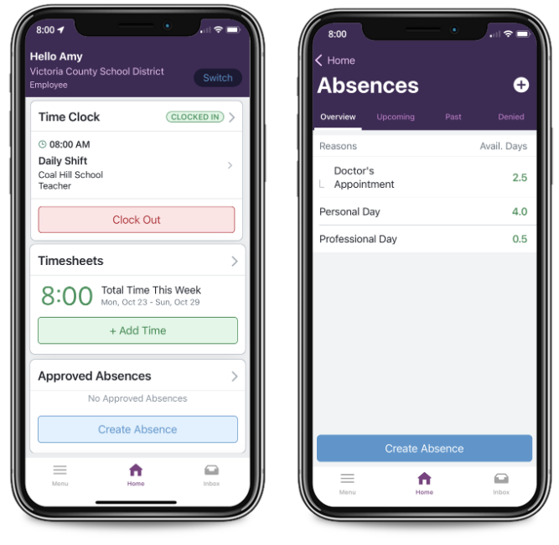
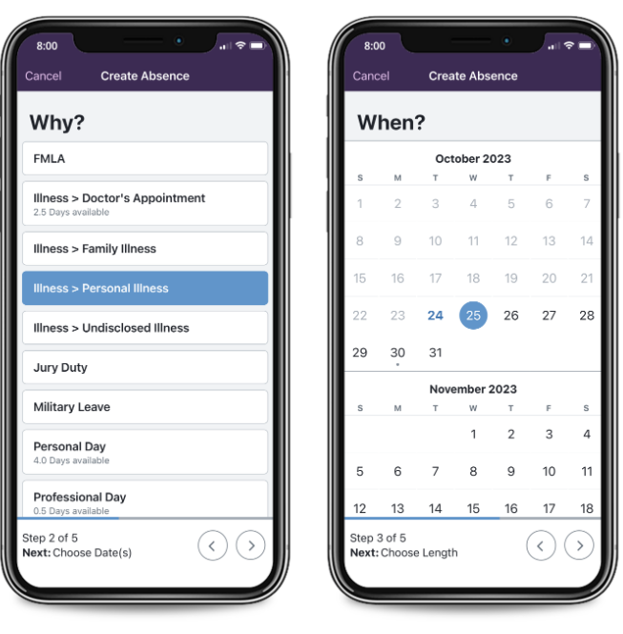
Absence Management Mobile App

Slide 14
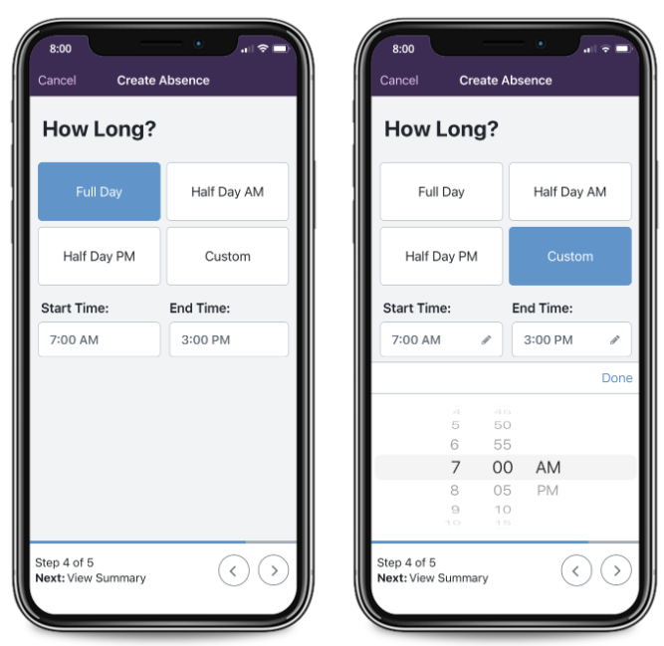
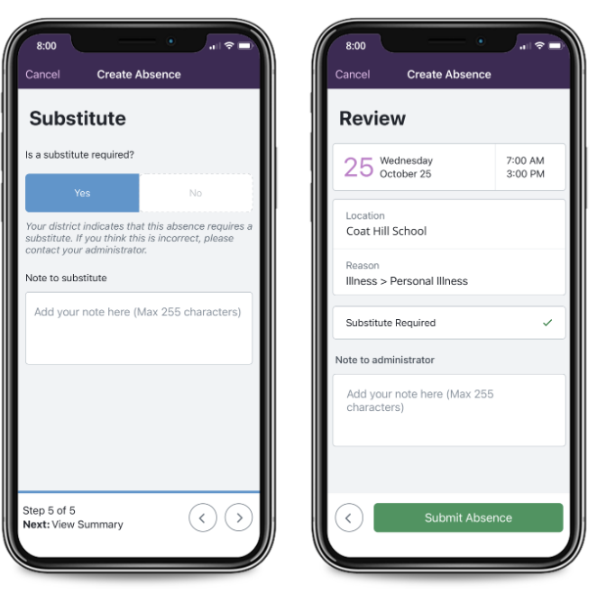
Absence Management Mobile App

Slide 15
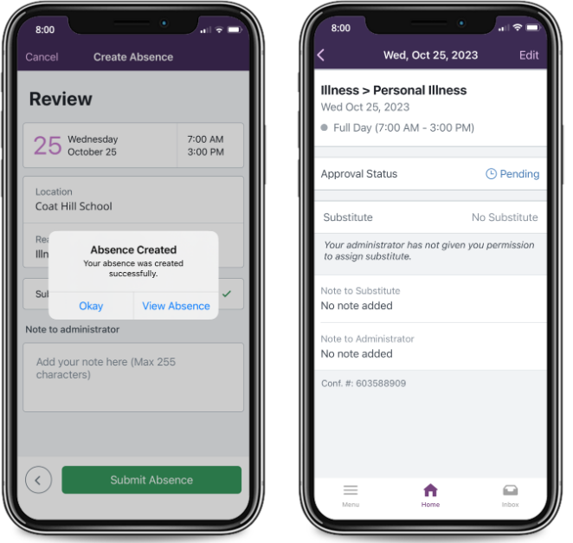
Absence Management Mobile App

Slide 16
Aesop
Contacts
Colleen Vollmer (First Contact)
Aesop secretary
Ext. 60133
Colleen Baker (Backup Contact)
Aesop secretary
Ext. 60132
Kim winters
Employee services & benefits manager
Ext. 63500

